Slide 1

DriverPass System Analysis
Arooj Saeed
Notes:
[No speaker notes required for this slide.]

Slide 2

System Requirements
The system should run in both web base and application
The user also required to input all the personal information and a profile photo.
The system shall be able to save the user credentials.
The system shall be able to give access the user about the package user selected.
Notes:
I believe the system should run in both web base and application. The system should be able to run properly as user might want to take online practice test with duration. The system needs to be updated or check for updates every 60 days.
The user also required to input all the personal information and a profile photo. Yes, it is case sensitive as the user is trusting the system and providing all the information. The system should inform the admin in critical situations like if the info is leaked, any other person is trying to get access of a user, the account password is tried many times etc.

Slide 3
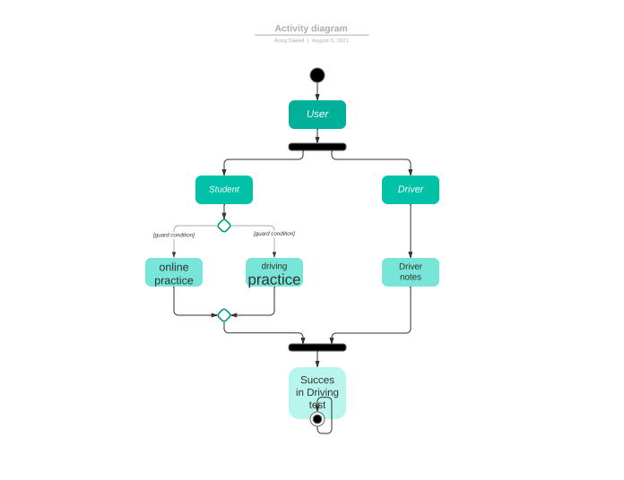
Use Case Diagram
Notes:
In this UML case diagram, I created a flow on how the system will actually flows. Starting by user, either student or driver, both will create their profiles. Student will take practice online exams and practice driving, while driver has to teach driving and make notes. After completing these steps both type of user will succeed in their work. Student and driver are both actors in this case. After clicking on Lucidchart UML case diagram tutorial, I was prompted to buy the subscription. so I did not watch any tutorial and create UML diagram the way I understand. The two technical requirements in DriverPass are creating and implementing database

Slide 4
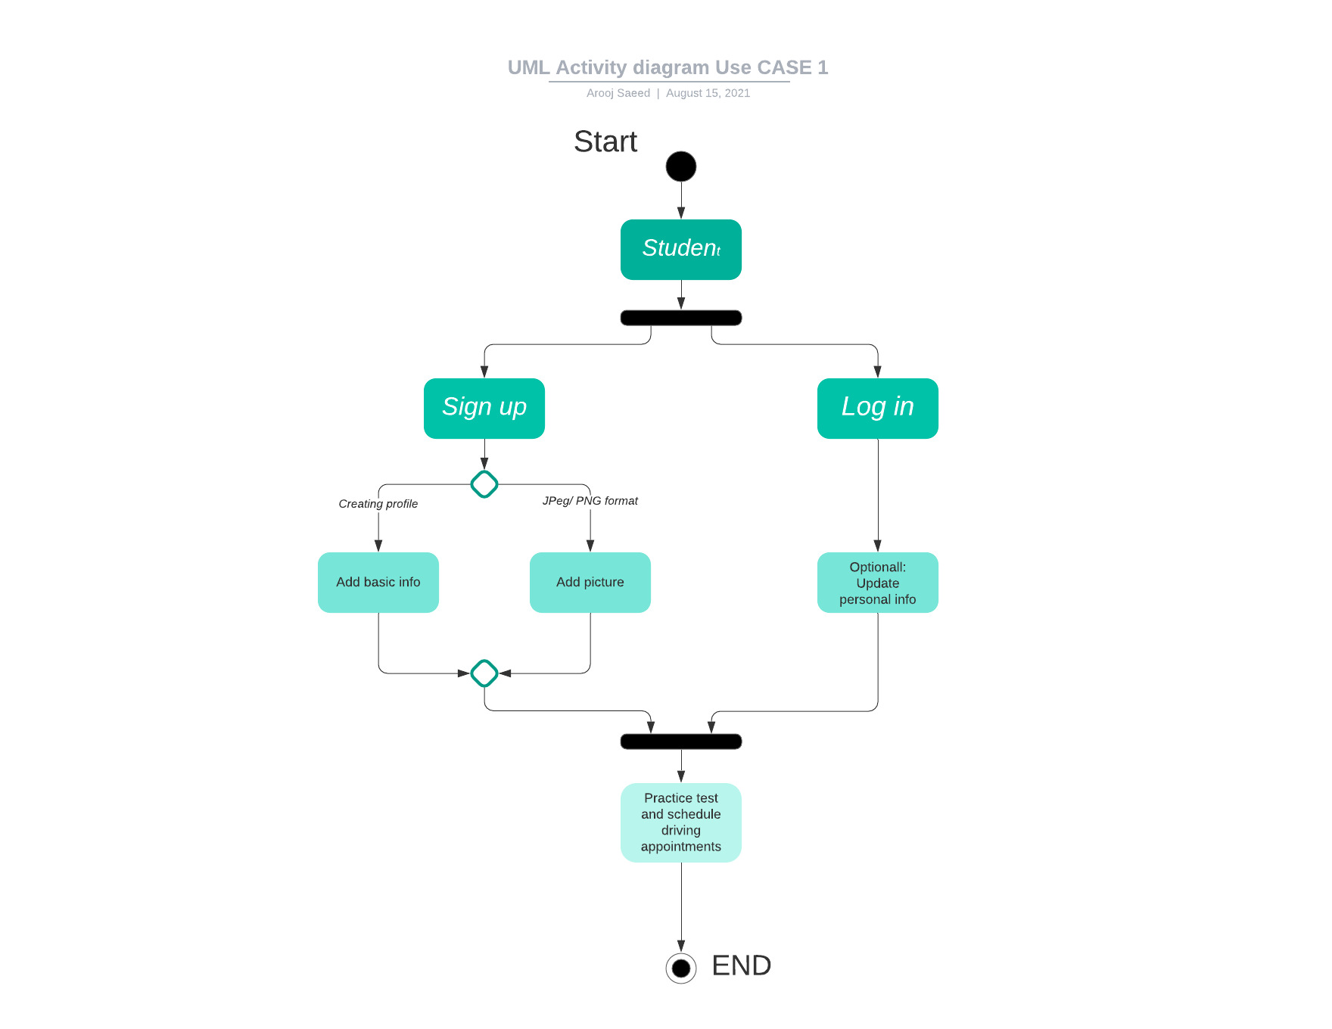
Activity Diagram
Notes:
In this diagram, the use case is Student. First the student is prompted to login/sign up. Crete or update profile. Then he will be able to practice test and given an option to schedule an appointment with Driver.

Slide 5
Security
Name
Email
Phone number
Credit card
photo
Notes:
The user needs to provide first & last name, email, phone number, credit card, profile photo etc. The data must be kept secured between the client and the server. The account should be able to freeze if there is hacking attempt. The It admin should be able to provide the user the temporary password so he can send the actual password.

Slide 6
System Limitations
Budget
Tech
Notes:
The limits would be budget and technology. The client did not provide info about budget.

